Slide 1
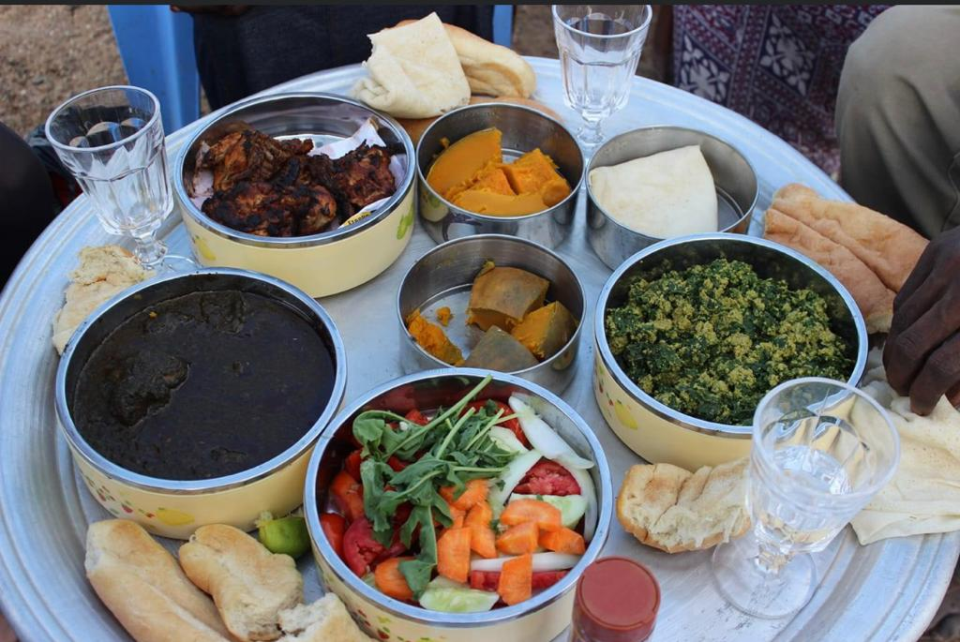
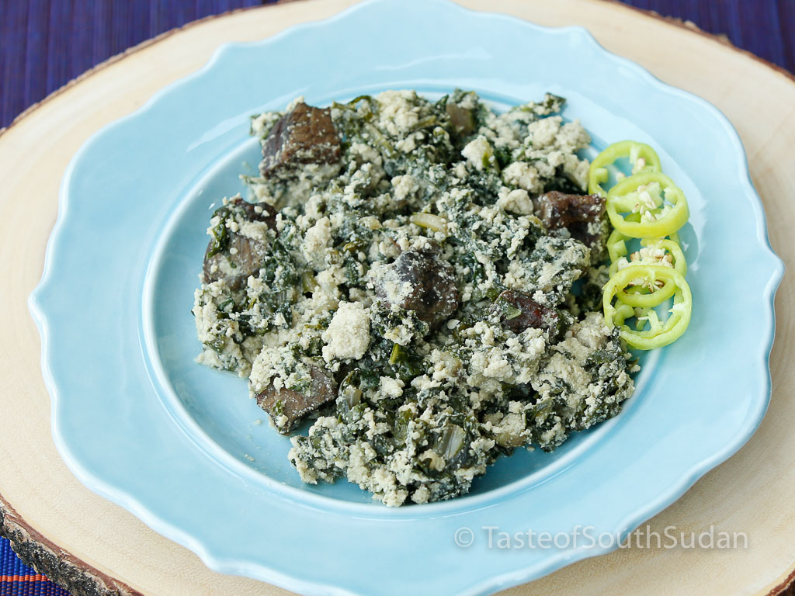
Project Title: SUDANILE KITCHEN MOBILE APPLICATION
By: WATUMANDE ELIWA WATULEVI SAMUEL ID: SWATEL2221
Major : SOFTWARE ENGINEERING
Supervisor: MR. FELIX CHEPSIROR

Slide 2
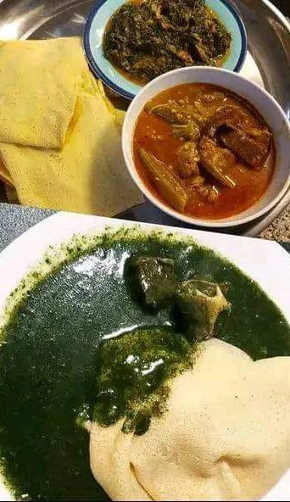
Introduction
South Sudanese cuisine is a vibrant and integral part of the nation's cultural identity, featuring unique dishes like Kisra (sorghum pancake), Ful Sudani (fava beans), Agashe (grilled meat skewers), and Moukh-baza (a rich peanut and meat stew). However, unlike many global cuisines, South Sudanese food remains largely undocumented and inaccessible in the digital space. Recipes are typically passed down orally through generations, making them difficult to preserve and share with a wider audience, including the South Sudanese diaspora and international food enthusiasts.

Slide 3

PROBLEM STATEMENT
Despite the rich and diverse culinary traditions of South Sudan, several key problems exist like a lack of Digital Preservation, Inaccessibility for the Diaspora and Global Audience, fragmented and Unreliable Information, and a cultural Disconnect.

Slide 4
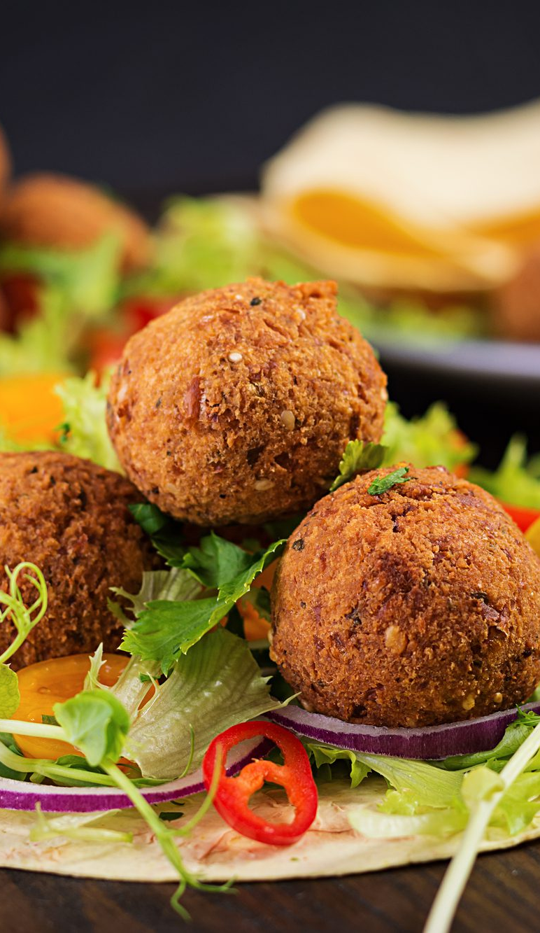
OBJECTIVES
To Design and Develop a Digital Archive: Create a structured database to store, categorize, and preserve a wide variety of authentic South Sudanese recipes
To Implement a Step-by-Step Guidance Module.
To Create a Culturally Immersive User Experience.
To Build a Multi-Platform Accessible Application.
To Incorporate a Community Contribution Feature (Optional/Future Scope).

Slide 5
Conceptual Diagram, System Model: [a diagram illustrating the architecture of the proposed System, highlighting the interaction between different modules ( overview of how the system will operate)]

Slide 6
Software:
IDE/Code Editor: Visual Studio Code.
Database Management System: MySQL.
API Testing: Postman.
Version Control: Git and GitHub/GitLab.
Design & Prototyping: Figma.
Tools to be used: Programming Languages: Software: Technologies:
Programming Languages:
Backend: Python, JavaScript.
Frontend (Web): JavaScript, HTML, CSS.
Mobile App: JavaScript or Dart (with Flutter) for cross-platform development.
Technologies:
Frameworks: React.js (Web), React Native/Flutter (Mobile), Django/Express.js (Backend API).
Database: PostgreSQL, SQLite (for development).
Media Storage: Cloudinary or AWS S3.
Hosting/Cloud Platform: Heroku, Netlify, or AWS/Google Cloud/Azure.

Slide 7
Modules
Module 1: User Onboarding & Profile Module
How it Works: A new user downloads the app or visits the website. They can browse public recipes without an account, but to save favorites or submit recipes, they must register.
Process:
User clicks "Sign Up" and enters their email/username and password, or uses a social login (Google/Facebook).
The User Management Module in the backend validates the information, checks for duplicates, and securely stores the new user's credentials in the Database.
Upon successful login, a session token is created and sent back to the client, allowing the user to stay logged in and access personalized features.
Module 2: Browse & Discover Module
How it Works: This is the main interface for users to explore the collection of recipes.
Process:
On the home screen, the client app sends a request to the backend's Recipe Management Module via the API Gateway.
The module queries the Database for a list of recipes, often applying default sorting (e.g., by popularity, newest, or randomly for discovery).
It also fetches category tags (e.g., "Breakfast”) and their associated counts.
The backend packages this data and sends it back. The client app then displays recipe cards with images, titles, and brief descriptions, along with category filters for easy navigation.
Module 3: Recipe Detail & Step-by-Step Guide Module
How it Works: When a user clicks on a specific recipe, they are taken to a detailed view that guides them through the cooking process.
Process:
The client sends a request for a specific recipe ID to the Recipe Management Module.
This module retrieves the detailed text data for the recipe from the Database, including the full ingredient list (with quantities) and numbered preparation steps.
Simultaneously, it retrieves URLs for the associated high-quality images and any instructional videos from the Media Storage service.
The client receives all this information and displays it in a clean, organized layout. Ingredients are listed, and the steps are presented in a sequential, easy-to-follow manner, possibly with a "cooking mode" that keeps the screen awake.
Module 4: Search Module
How it Works: This module allows users to find specific recipes based on their queries.
Process:
The user types a search term into the search bar (e.g., "peanut stew").
The client sends this query to the backend's Search Module.
The Search Module performs a text search across relevant fields in the Database, such as recipe titles, ingredient names, and description text. More advanced searches could use tags like "Main Dish" or "Vegetarian."
The module returns a list of matching recipes. The client then displays these results, often highlighting why the recipe matched (e.g., "Matched ingredient: Peanut")

